Slide 1

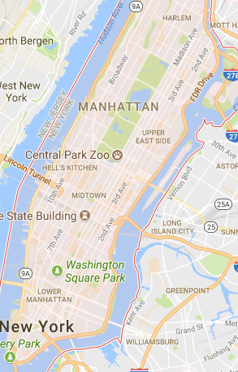
Feature: ‘Mean Duration of Similar Trips’
For each trip in the Test set:
Find all ‘Similar Trips’ in the Train set:
Pickup location within 600m of and drop-off location with 600m
Pickup Time +/- 120 minutes
Within same ‘Day Group’
M, F
T, W, T
S, S
Calculate the count, mean, SD and ‘SD percentage of mean’.
Drop-off
Pickup

Slide 2
Exploration 1: Replace Existing Target with New Feature
Baseline Submit File
New Feature
New Submit File
.38948
184th of 941
Top 20%
Where count>=8 and SDP <=0.35:
Replace Target with NF (mean trip_duration of similar trips)
(24,774 rows adjusted)
.39117
No improvement
Next steps:
Include trips in opposite direction as ‘similar trips’
Calculate NF for Train and process through Xgboost model
Kernel: https://www.kaggle.com/gaborfodor/from-eda-to-the-top-lb-0-367

Slide 3
Exploration 2: As a New Feature in the Xgboost Model
Train Dataset
New Submit File
If count>=X and SDP <.X:
Then NF= ‘Mean Duration of Similar Trips’
Else NF = -1
.?????
Xx of xx
Top ??%
Add New Feature (NF)
Xgboost Model
Kernel: https://www.kaggle.com/gaborfodor/from-eda-to-the-top-lb-0-367

